Slide 1
Assuming the Role of the Systems Analyst
1
Systems Analysis and Design
Kendall & Kendall

Slide 2
Systems Analysts Recommend, Design, and Maintain Many Types of Systems for Users
  Transaction Processing Systems (TPS)
  Office Automation Systems (OAS)
  Knowledge Work Systems (KWS)
  Management Information Systems (MIS)
  Decision Support Systems (DSS)
  Expert Systems (ES)
  Executive Support Systems (ESS)
  Group Decision Support Systems (GDSS)
  Computer-Supported Collaborative Work Systems (CSCWS)
Kendall & Kendall
1-<number>
Notes:
Information systems are developed for different purposes, depending on the needs of the business.
Operational
TPS
Knowledge Level
OAS
KWS
Higher Level
MIS
DSS
ES
Strategic Level
ESS
GDSS
CSCWS

Slide 3
Operational Level
Transaction Processing System (TPS)
  Process large amounts of data for routine business transactions
  Boundary-spanning
  Support the day-to-day operations of the company
  Examples: Payroll Processing, Inventory Management
Kendall & Kendall
1-<number>
Notes:
Eliminates the tedium of necessary operational transactions and reduces the time once required to perform them manually.
TPS are boundary-spanning systems that permit the organization to interact with external environments.
It is essential to the day-to-day operations of business that Transaction processing systems function smoothly and without interruption.

Slide 4
Knowledge Level
Office Automation System (OAS)
  Supports data workers who share information, but do not usually create new knowledge
  Examples: Word processing, Spreadsheets, Desktop publishing, Electronic scheduling, Communication through voice mail, Email, Video conferencing
Knowledge Work System (KWS)
  Supports professional workers such as scientists, engineers, and doctors
  Examples: computer-aided design systems, virtual reality systems, investment workstations
Kendall & Kendall
1-<number>
Notes:
OAS – support data workers, who do not usually create new knowledge but rather analyze information so as to transform data or manipulate it in some way before sharing it with, or formally disseminating it throughout, the organization and, sometimes beyond.
KWS – support professional workers such as scientists, engineers, and doctors by aiding them in their efforts to create new knowledge and by allowing them to contribute it to the organization or to society at large.
(CAD) Computer Aided Design - Automates creation, revision of products, and services
Virtual Reality - Interactive software creates simulations of real world activities
Investment workstations - Special work station to access and manipulate massive amounts of financial data

Slide 5
Higher Level
Management Information System (MIS)
  Support a broad spectrum of organizational tasks including decision analysis and decision making
  Examples: profit margin by sales region, expenses vs. budgets
Decision Support System (DSS)
  Aids decision makers in the making of decisions
  Examples: financial planning with what-if analysis, budgeting with modeling
Expert System (ES)
  Captures and uses the knowledge of an expert for solving a particular problem which leads to a conclusion or recommendation
  Examples: MYCIN, XCON
Kendall & Kendall
1-<number>
Notes:
MIS – Support management functions of organization. Transaction processing systems are a subset of management information systems. MIS includes a wider spectrum which includes decision analysis and decision making.
Management information systems use a database which contains both data and models that help the user interpret and apply the data. The product produced by Management information systems is that used in decision making.
DSS – Much like an MIS except that it emphasizes the support of decision making in all its phases, although the actual decision is still left up to the decision maker. Closely tailored to the person or group using them.
ES – Uses the approaches of AI reasoning to solve the problems put to them by business and other users. These systems select the best solution to a problem or a specific class of problems.
Expert systems consist of:
knowledge base
inference engine – connects the user with the system by processing requests
user interface

Slide 6
Strategic Level
Executive Support System (ESS)
  Helps executives to make unstructured strategic decisions in an informed way
  Examples: drill-down analysis, status access
Group Decision Support System (GDSS)
  Permit group members to interact with electronic support
  Examples: email, Lotus Notes
Computer-Supported Collaborative Work System (CSCWS)
  CDCWS is a more general term of GDSS
  May include software support called “groupware” for team collaboration via network computers
  Example: video conferencing, Web survey system
Kendall & Kendall
1-<number>
Notes:
ESS – Help executives to make decisions at the strategic level by providing graphics and communication support technologies in accessible places. They help executives address unstructured decision problems by creating an environment which helps them think about strategic problems in an informed way.
GDSS – aids in group collaboration permitting group members to interact with electronic support such as polling, questionnaires, brainstorming, and scenario creation. Can be used to minimize negative group behaviors – lack of participation, domination by vocal group members, and “group think” decision making.
CSCWS – This is the more general term for group decision support systems.

Slide 7
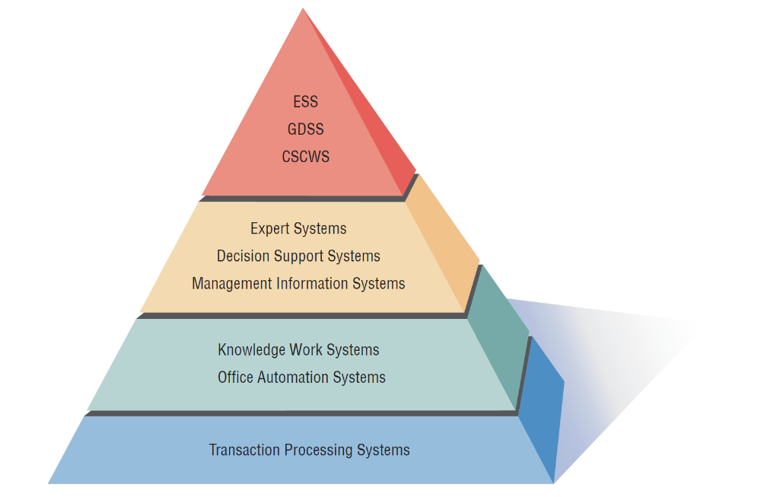
A systems analyst may be involved with any or all of these systems at each organization level
Strategic Level
Higher Level
Knowledge Level
Operational Level
Kendall & Kendall
1-<number>
Notes:
As we move from the bottom to the top, each level represents a higher level of decision support. The bottom level or organizational level supported by TPS provides very structured decision support while the top level or strategic level supported by ESS, GDSS and CSCWS provides semi-structured and unstructured decision support.

Slide 8
Integrating New Technologies into Traditional Systems
Ecommerce and Web Systems
Enterprise Resource Planning Systems
Wireless Systems
Open Source Software
Need for Systems Analysis and Design
Kendall & Kendall
1-<number>
Notes:
As new technologies are adopted they will need to be integrated with traditional systems. Systems analyst will be using these new technologies in helping people work to integrate ecommerce applications into traditional businesses or as they begin entirely new ebusinesses.

Slide 9
Ecommerce and Web Systems
Benefits
  Increasing user awareness of the availability of a service, product, industry, person, or group
  The possibility of 24-hour access for users
  Improving the usefulness and usability of interface design
  Creating a system that can extend globally rather than remain local, thus reaching people in remote locations without worry of the time zone in which they are located
Kendall & Kendall
1-<number>
Notes:
The systems covered can have much greater functionality if they are migrated to the World Wide Web or if they are originally conceived and implemented as Web-based technologies.

Slide 10
Enterprise Resource Planning Systems (ERP)
Performs integration of many information systems existing on different management levels and within different functions
Example: SAP, Oracle
Kendall & Kendall
1-<number>
Notes:
Instituting ERP requires enormous commitment and organizational change.
Generally systems analysts server as consultants to ERP endeavors that use proprietary software.
To properly design, install, maintain, update, and use a ERP package, analysts as well as some users require vendor training, support, and maintenance.
SAP-System Application and products in data processing

Slide 11
Wireless Systems
System analyst may be asked to design standard or wireless communication networks that integrate voice, video and email into organizational intranets or industry extranets
System analyst may also be asked to develop intelligent agents
Wireless communication is referred as m-commerce (mobile commerce)
Kendall & Kendall
1-<number>
Notes:
Analysts are being called to design a plethora of new systems and applications.
May be asked to develop under the standard called Bluetooth.
Intelligent agents are software that can assist users with tasks in which the software learns preferences from of users over time and then acts on those preferences.
Microsoft is developing software based on Bayesian statistics and decision making theory in combination with monitoring a user’s behavior concerning the handling of incoming information. Referred to as notification manager software that also places a dollar value on each piece of incoming information.

Slide 12
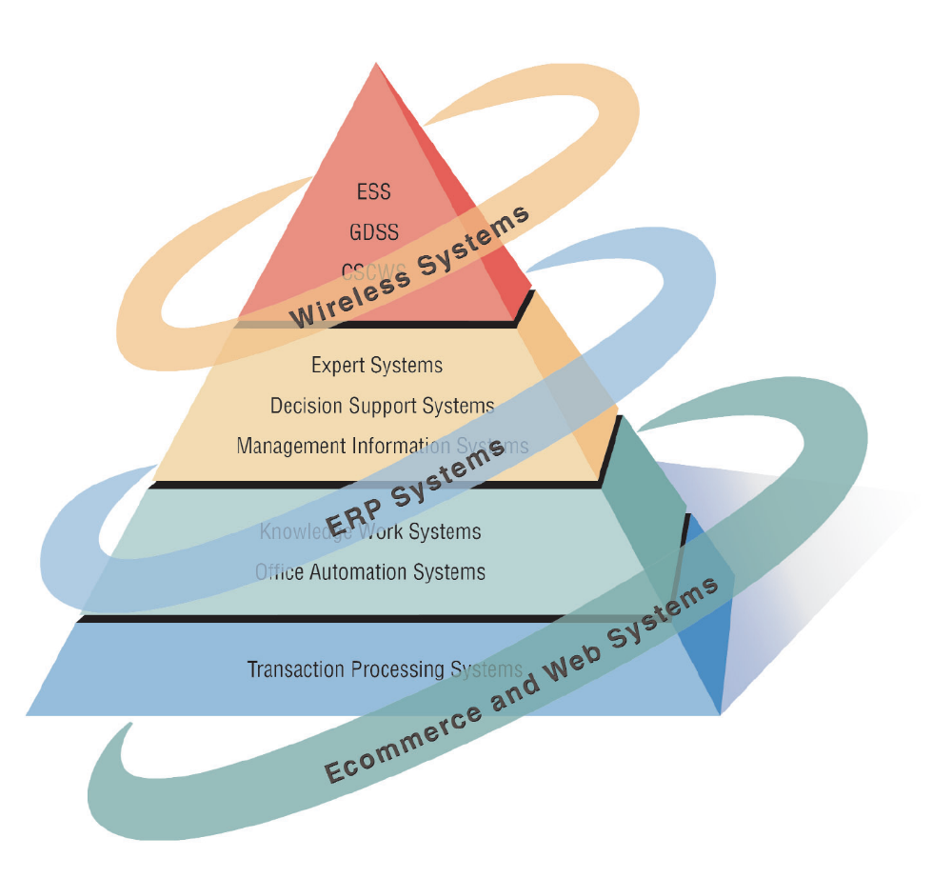
Figure 1.2 Systems analysts need to be aware that integrating technologies affects all types of systems
Kendall & Kendall
1-<number>

Slide 13
Open Source Software
An alternative of traditional software development where proprietary code is hidden from the users
Open source software is free to distribute, share and modify
Characterized as a philosophy rather than simply the process of creating new software
Example: Linux Operating System, Apache Web Server, Mozilla Firefox Web browser
Kendall & Kendall
1-<number>
Notes:
A movement to create, distribute, share and modify software which is not proprietary.
It’s not a monolithic movement instead it has been categorized into four community types:
Ad hoc
Standardized
Organized
Commercial
The four communities in turn differ from each other on six key dimensions:
General structure
Environment
Goals
Methods
User community
Licensing

Slide 14
Need for Systems Analysis and Design
Installing a system without proper planning leads to great user dissatisfaction and frequently causes the system to fall into disuse
New technologies also are driving the need for systems analysis Exp: Ajax and Ruby on Rails
A series of processes systematically undertaken to improve a business through the use of computerized information systems
Kendall & Kendall
1-<number>
Notes:
User involvement throughout the systems project is critical to the successful development of computerized information systems.
New technologies are also driving the need for systems analysis. Ajax and Ruby on Rails are two examples.

Slide 15
Roles of the Systems Analyst
The analyst must be able to work with people of all descriptions and be experienced in working with computers
Three primary roles:
  Consultant
  Supporting Expert
  Agent of change
Kendall & Kendall
1-<number>
Notes:
The systems analyst systematically assesses how users interact with technology and business function by examining the inputting of information with the intend of improving organizational processes.
The analyst needs to play many roles, balancing several at the same time.
Consultant: Advantage – can bring with them a fresh perspective that other people in an organization do not possess.
Disadvantage – true organizational structure can never be known to an outsider.
Supporting expert:
Draws on professional expertise concerning computer hardware and software and their uses in the business.
Serves as a resource for those who are working on and managing other projects
Agent of change:
A person who serves as a catalyst for change, develops a plan for change, and works with others in facilitating that change.

Slide 16
Qualities of the Systems Analyst
Problem solver
Communicator
Strong personal and professional ethics
Self-disciplined and self-motivated
Kendall & Kendall
1-<number>
Notes:
The successful systems analyst must possess a wide range of qualities.
Problem solver – views the analysis of problems as a challenge and enjoys devising workable solutions.
Communicator – capable of relating meaningfully to other people over extended periods over time. Need enough computer experience to program, to understand the capabilities of computers, glean information requirements from users, and communicate what is needed to programmers.
Strong personal and professional ethics – they need to shape their client relationships
Self-disciplined and self-motivated – must be able to coordinate other people as well as innumerable project resources.

Slide 17
Systems Development Life Cycle (SDLC)
The systems development life cycle is a phased approach to solving problems
Developed through the use of a specific cycle of analyst and user activities
Each phase has unique user activities
Kendall & Kendall
1-<number>
Notes:
Analysts disagree on exactly how many phases there are in the SDLC.
Each phase consists of activities which overlap into other phases and then taper off, rather then done in separate steps.

Slide 18
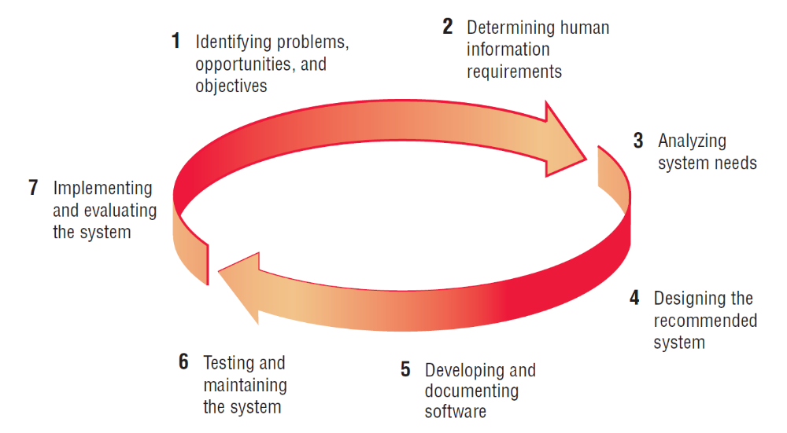
Figure 1.3 The seven phases of the systems development life cycle
Kendall & Kendall
1-<number>
Notes:
Identifying problem Developing software
Determining requirements Testing system
Analyzing needs Implementing system
Designing system

Slide 19
Identifying Problems, Opportunities, and Objectives
Activity:
  Interviewing user management
  Summarizing the knowledge obtained
  Estimating the scope of the project
  Documenting the results
Output:
  Feasibility report containing problem definition and objective summaries from which management can make a decision on whether to proceed with the proposed project
People Involved:
  Users, Analysts, System Managers
Kendall & Kendall
1-<number>
Notes:
Critical to the success of the rest of the project, because no one wants to waste time addressing the wrong problem.
Problems – generally the reason the analyst was called in in the first place.
Opportunities – situations that the analyst believes can be improved through the use of computerized information systems.
Objectives – how can the business reach its objectives by addressing specific problems or opportunities.

Slide 20
Determining Human Information Requirements
Activity:
  Interviewing
  Sampling and investing hard data
  Questionnaires
  Observe the decision maker’s behavior and environment
  Prototyping
  Learn the who, what, where, when, how, and why of the current system
Output:
  Analyst understands how users accomplish their work when interacting with a computer; and begin to know how to make the new system more useful and usable. The analyst should also know the business functions and have complete information on the people, goals, data and procedure involved
Kendall & Kendall
1-<number>
Notes:
Determining human needs of the users involved.
Uses activities to pose and answer questions concerning human-computer interaction:
What are the users strengths and limitations?
Trying to understand what information users need to perform their jobs.
Who – the people who are involved
What – the business activity
Where – the environment in which the work takes place
When – the timing
How – how the current procedures are performed
Why – why the system uses the current system

Slide 21
Analyzing System Needs
Activity:
  Create data flow diagrams
  Complete the data dictionary
  Analyze the structured decisions made
    Decision Table, Decision tree or Structured English
  Prepare and present the system proposal
Output:
  Recommendations on what, if anything, should be done using cost benefit analysis
Kendall & Kendall
1-<number>
Notes:
Data Flow Diagrams – chart the input, processes, and output of the business’s functions in a structured graphical form.
Data dictionary – lists all the data items used in the system, as well as their specifications.
Structured decisions made – those for which the conditions, condition alternatives, actions, and action rules can be determined.
Structure decision methods:
structures English
decision tables
decision trees
System proposal – summarizes what has been found
about users
usability and usefulness of current system
provides cost/benefit analysis of alternatives
makes recommendations on what (if anything) should be done
The recommendation or solution is based on the analysts individual qualities and professional training and their interaction with users.

Slide 22
Designing the Recommended System
Activity:
  Design procedures for data entry
  Design the human-computer interface
  Design system controls
  Design files and/or database
  Design backup procedures
Output
  Model of the actual system
Kendall & Kendall
1-<number>
Notes:
Uses the information collected earlier to accomplish the logical design of the information system:
designs procedures for users to help them accurately enter data
provides for users to complete effective input to the information system
devises the human-computer interface
designs files or databases that will store the data needed by decision makers
designs output (onscreen or printed)
designs controls and backup procedures

Slide 23
Developing and Documenting Software
Activity:
  System analyst works with programmers to develop any original software
  Works with users to develop effective documentation
  Programmers design, code, and remove syntactical errors from computer programs
  Document software with help files, procedure manuals, and Web sites with Frequently Asked Questions
Output:
  Computer programs
  System documentation
Kendall & Kendall
1-<number>
Notes:
The analyst uses structure charts and pseudocode to communicate to the programmer what needs to be programmed.
Documentation includes:
procedure manuals
online help
Web sites
“Read Me” files
Because users are involved from the beginning, the documentation should address the questions they have raised and solved jointly with the analyst.

Slide 24
Testing and Maintaining the System
Activity:
  Test the information system
  System maintenance
  Maintenance documentation
Output:
  Problems, if any
  Updated programs
  Documentation
Kendall & Kendall
1-<number>
Notes:
Testing should take place first with sample data and then with actual data.
Testing is done by both the programmers and the analyst
The maintenance started here is carried out routinely through the life of the system.
updates may be performed via a vendor site on the Web.

Slide 25
Implementing and Evaluating the System
Activity:
  Train users
  Analyst plans smooth conversion from old system to new system
  Review and evaluate system
Output:
  Trained personnel
  Installed system
Kendall & Kendall
1-<number>
Notes:
Training users to handle the system.
System conversion – converting files from old formats to new ones, or building a database, installing equipment, and bringing the new system into production.
Actually evaluation takes place during every phase.

Slide 26
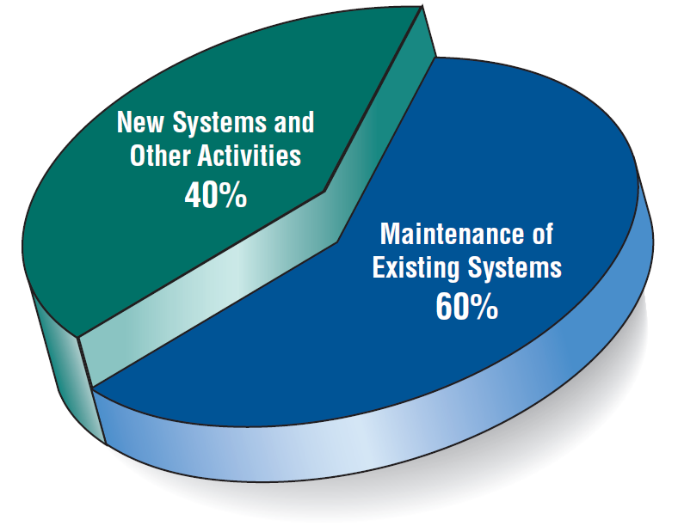
Figure 1.4 Some researchers estimate that the amount of time spent on systems maintenance may be as much as 60 percent of the total time spent on systems projects
Kendall & Kendall
1-<number>

Slide 27
The Impact of Maintenance
Maintenance is performed for two reasons
  Removing software errors, and
  Enhancing existing software
Over time the cost of continued maintenance will be greater than that of creating an entirely new system. At that point it becomes more feasible to perform a new systems study
Kendall & Kendall
1-<number>
Notes:
Computer programs must be modified and kept up to date.
Reasons for enhancing existing software –
users request additional features
business changes over time
hardware and software change

Slide 28
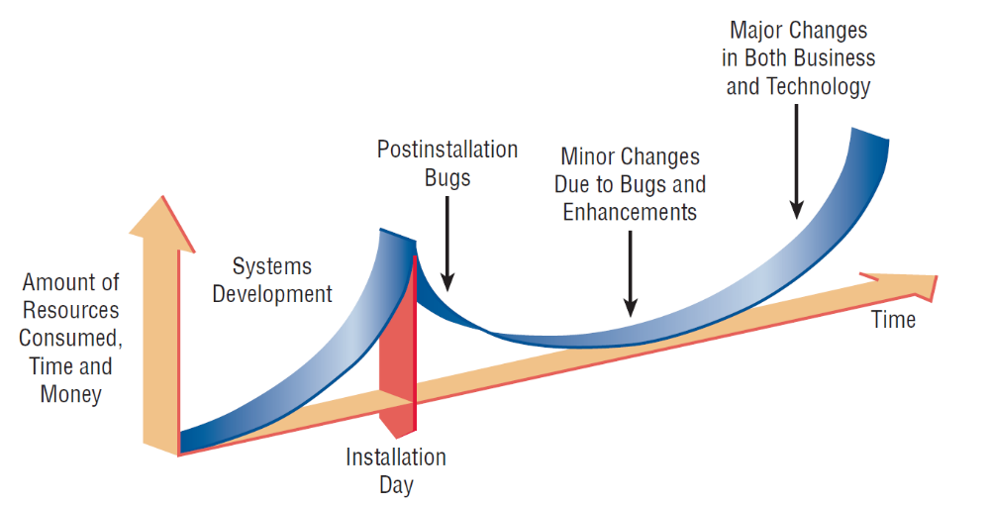
Figure 1.5 Resource consumption over the system life
Kendall & Kendall
1-<number>
Notes:
Area under the curve represents the total dollar amount.
Eventually maintenance exceeds the cost of a creating a new system. At that point a new systems study should be untaken.

